Slide 1
More-Sophisticated Behavior
Using library classes to implement some more advanced functionality
7.0

Slide 2
Main concepts to be covered
Using library classes
Reading documentation

Slide 3
The Java class library
Thousands of classes.
Tens of thousands of methods.
Many useful classes that make life much easier.
Library classes are often inter-related.
Arranged into packages.

Slide 4
Working with the library
A competent Java programmer must be able to work with the libraries.
You should:
know some important classes by name;
know how to find out about other classes.
Remember:
we only need to know the interface, not the implementation.

Slide 5
A Technical Support System
A textual, interactive dialog system.
Idea based on 'Eliza' by Joseph Weizenbaum (MIT, 1960s).
Explore tech-support-complete …
… The program appears to respond intelligently to the user's typed input.
Explore tech-support1 – an incomplete version.

Slide 6
Main loop structure
boolean finished = false;
while(!finished) {
do something
if(exit condition) {
finished = true;
}
else {
do something more
}
}
A common iteration pattern.

Slide 7
Modularization

Slide 8
Main loop body in SupportSystem
String input = reader.getInput();
...
String response = responder.generateResponse();
System.out.println(response);
NB: input is ignored by the Responder in this version.

Slide 9
The exit condition
String input = reader.getInput();
if(input.startsWith("bye")) {
finished = true;
}
Where does 'startsWith' come from?
What is it? What does it do?
How can we find out?

Slide 10
Reading class documentation
Documentation of the Java libraries in HTML format;
Readable in a web browser
Class API: Application Programmers' Interface
Interface description for all library classes

Slide 11
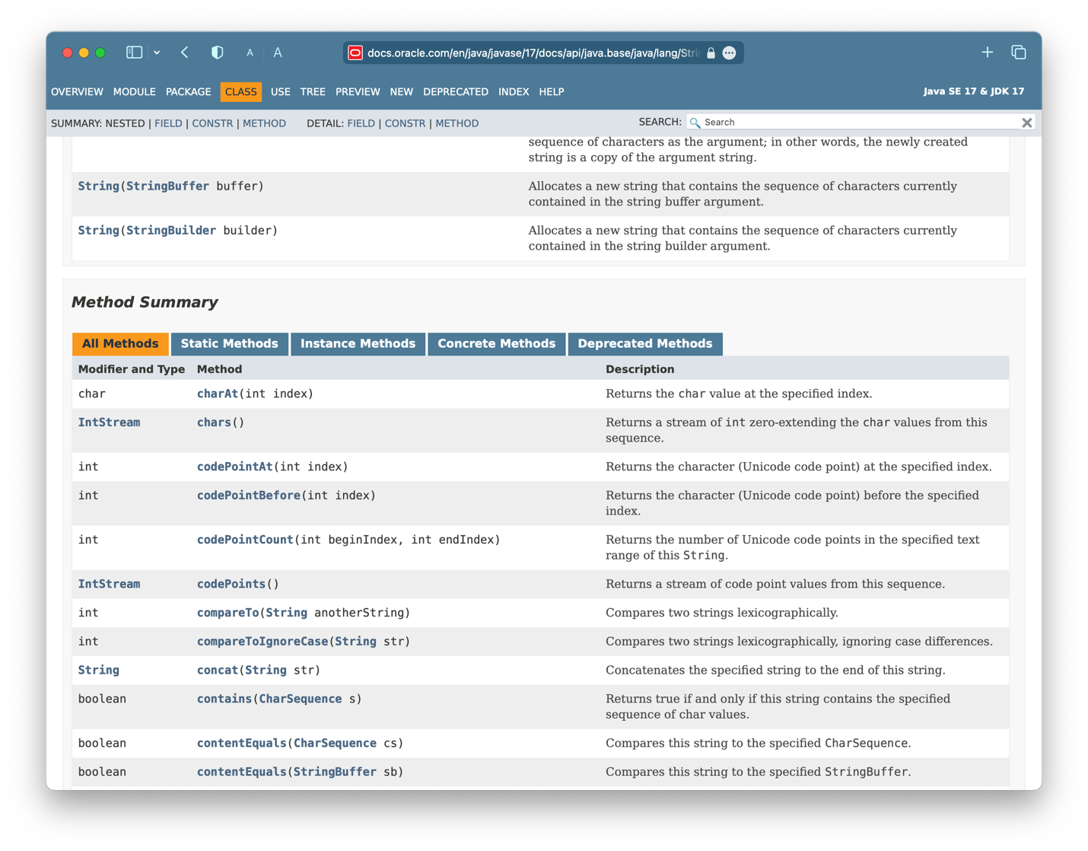
API Reference

Slide 12
Interface vs implementation
The documentation includes
the name of the class;
a general description of the class;
a list of constructors and methods
return values and parameters for constructors and methods
a description of the purpose of each constructor and method
the interface of the class

Slide 13
Interface vs implementation
The documentation does not include
private fields (most fields are private)
private methods
the bodies (source code) of methods
the implementation of the class

Slide 14
Documentation for startsWith
startsWith
public boolean startsWith(String prefix)
Tests if this string starts with the specified prefix.
Parameters:
prefix - the prefix.
Returns:
true if the …; false otherwise

Slide 15
Methods from String
contains
endsWith
indexOf
substring
toUpperCase
trim
Beware: strings are immutable!

Slide 16
Using library classes
Classes organized into packages.
Classes from the library must be imported using an import statement;
except from the java.lang package.
They can then be used like classes from the current project.

Slide 17
Packages and import
Single classes may be imported: import java.util.ArrayList;
Whole packages can be imported: import java.util.*;
Importation does not involve source code insertion.

Slide 18
Adding random behavior
The library class Random can be used to generate random numbers:
import java.util.Random;
...
Random rand = new Random();
...
int num = rand.nextInt();
int value = 1 + rand.nextInt(100);
int index = rand.nextInt(list.size());

Slide 19
Selecting random responses
public Responder()
{
randomGenerator = new Random();
responses = new ArrayList<>();
fillResponses();
}
public void fillResponses()
{
fill responses with a selection of response strings
}
public String generateResponse()
{
int index = randomGenerator.nextInt(responses.size());
return responses.get(index);
}

Slide 20
Text blocks
We sometimes want a multi-line string.
Here are two alternatives: "First line.\n" + "Second line." "First line.\nSecond line."
A text block is clearer: """ First line. Second line. """

Slide 21
Parameterized classes
The documentation includes provision for a type parameter:
ArrayList<E>
These type names reappear in the parameters and return types of the methods of the class:
E get(int index)
boolean add(E e)

Slide 22
Parameterized classes
The types in the documentation are placeholders for the types we use in practice:
An ArrayList<Track> actually has methods:
Track get(int index)
boolean add(Track e)

Slide 23
Review
Java has an extensive class library.
A good programmer must be familiar with the library.
The documentation tells us what we need to know to use a class (its interface).
Some classes are parameterized with additional types.
Parameterized classes are also known as generic classes or generic types.

Slide 24
Further library classes
Using library classes to implement some more advanced functionality

Slide 25
Main concepts to be covered
Further library classes:
Set – avoiding duplicates
Map – creating associations
Writing documentation:
javadoc

Slide 26
Using Sets
import java.util.HashSet;
...
HashSet<String> mySet = new HashSet<>();
mySet.add("one");
mySet.add("two");
mySet.add("three");
for(String element : mySet) {
do something with element
}
Compare with code for an ArrayList!

Slide 27
Tokenising Strings
public HashSet<String> getInput()
{
System.out.print("> ");
String inputLine = reader.nextLine().trim().toLowerCase();
String[] wordArray = inputLine.split(" ");
HashSet<String> words = new HashSet<String>();
for(String word : wordArray) {
words.add(word);
}
return words;
}

Slide 28
Maps
Maps are collections that contain pairs of objects.
Parameterized with two types.
Pairs consist of a key and a value.
Lookup works by supplying a key, and retrieving a value.
Example: a contacts list.

Slide 29
Using maps
A map with Strings as keys and values
:HashMap
"Charles Nguyen"
"(531) 9392 4587"
"Lisa Jones"
"(402) 4536 4674"
"Hiroshi Ito"
"(998) 5488 0123"

Slide 30
Using maps
HashMap <String, String> contacts = new HashMap<>();
contacts.put("Charles Nguyen", "(531) 9392 4587");
contacts.put("Lisa Jones", "(402) 4536 4674");
contacts.put("Hiroshi Ito", "(998) 5488 0123");
String number = contacts.get("Lisa Jones");
System.out.println(number);

Slide 31
HashMap in Responder
private HashMap <String, String> responseMap;
...
responseMap.put("crash", "Which version is this?");
...
String response = responseMap.get(word);
if(response != null) {
...
}

Slide 32
List, Map and Set
Alternative ways to group objects.
Varying implementations available:
ArrayList, LinkedList
HashSet, TreeSet
But HashMap is unrelated to HashSet, despite similar names.
The second word reveals organizational relatedness.

Slide 33
Collections and primitive types
The generic collection classes can be used with all class types ...
… but what about the primitive types: int, boolean, etc.?
Suppose we want an ArrayList of int?

Slide 34
Wrapper classes
Primitive types are not objects types. Primitive-type values must be wrapped in objects to be stored in a collection!
Wrapper classes exist for all primitive types:
simple type wrapper class
int Integer
float Float
char Character
... ...
Notes:
Note that there is no simple mapping rule from primitive name to wrapper name!

Slide 35
Wrapper classes
wrap the value
int i = 18;
Integer iwrap = new Integer(i);
…
int value = iwrap.intValue();
unwrap it
In practice, autoboxing and unboxing mean we don't often have to do this explicitly.

Slide 36
Autoboxing and unboxing
private ArrayList<Integer> markList;
...
public void storeMark(int mark)
{
markList.add(mark);
}
autoboxing
int firstMark = markList.remove(0);
unboxing

Slide 37
Writing class documentation
Your own classes should be documented the same way library classes are.
Other people should be able to use your class without reading the implementation.
Make your class a potential 'library class'!

Slide 38
Elements of documentation
Documentation for a class should include:
the class name
a comment describing the overall purpose and characteristics of the class
a version number
the authors' names
documentation for each constructor and each method

Slide 39
Elements of documentation
The documentation for each constructor and method should include:
the name of the method
the return type
the parameter names and types
a description of the purpose and function of the method
a description of each parameter
a description of the value returned

Slide 40
javadoc
Class comment:
/**
* The Responder class represents a response
* generator object. It is used to generate an
* automatic response.
*
* @author Michael Kölling and David J. Barnes
* @version 1.0
*/

Slide 41
javadoc
Method comment:
/**
* Read a line of text from standard input (the text
* terminal), and return it as a set of words.
*
* @param prompt A prompt to print to screen.
* @return A set of strings, where each String is
* one of the words typed by the user
*/
public HashSet<String> getInput(String prompt)
{
...
}

Slide 42
Public vs private
Public elements are accessible to objects of other classes:
Fields, constructors and methods
Fields should not be public.
Private elements are accessible only to objects of the same class.
Only methods that are intended for other classes should be public.

Slide 43
Information hiding
Data belonging to one object is hidden from other objects.
Know what an object can do, not how it does it.
Information hiding increases the level of independence.
Independence of modules is important for large systems and maintenance.

Slide 44
Code completion
The BlueJ editor supports lookup of methods.
Use Ctrl-space after a method-call dot to bring up a list of available methods.
Use Return to select a highlighted method.

Slide 45
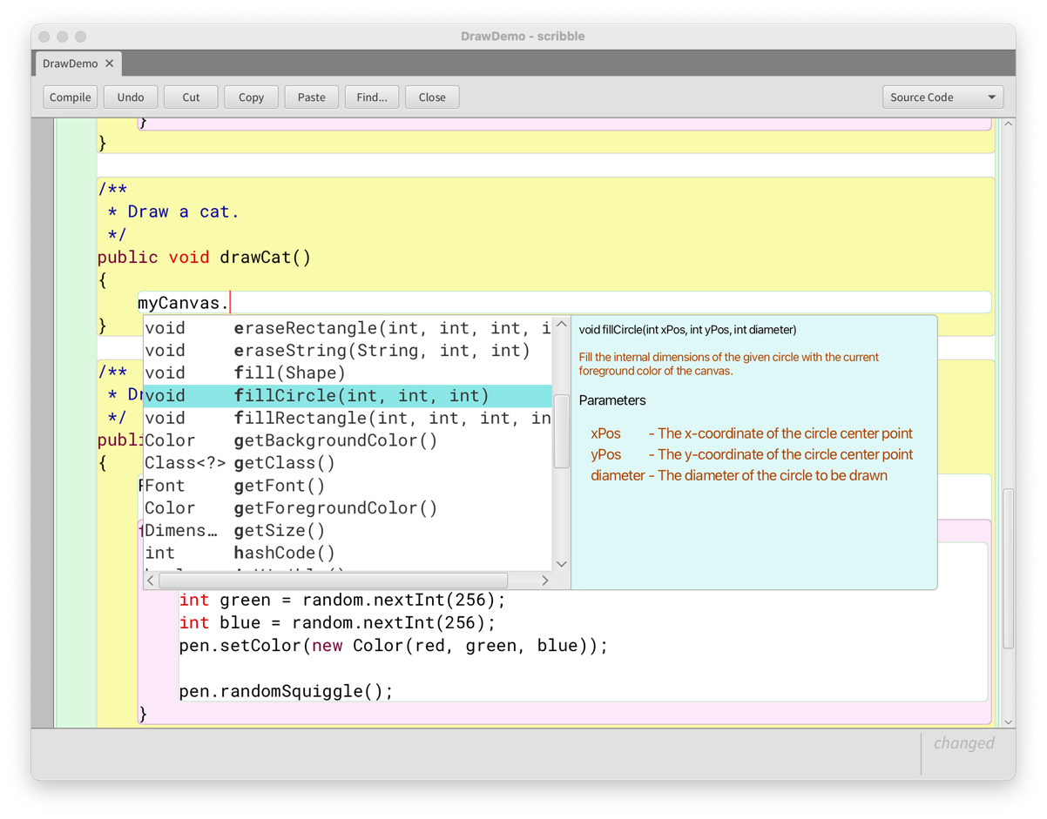
Code completion in BlueJ

Slide 46
Review
Java has an extensive class library.
A good programmer must be familiar with the library.
The documentation tells us what we need to know to use a class (interface).
The implementation is hidden (information hiding).
We document our classes so that the interface can be read on its own (class comment, method comments).

Slide 47
Class variables and constants

Slide 48
Class variables
A class variable is shared between all instances of the class.
In fact, it belongs to the class and exists independent of any instances.
Designated by the static keyword.
Public static variables are accessed via the class name; e.g.:
Thermometer.boilingPoint

Slide 49
Class variables

Slide 50
Constants
A variable, once set, can have its value fixed.
Designated by the final keyword.
final int MAX_CLASS_SIZE = 10;
Final fields must be set in their declaration or the constructor.
Combing static and final is common.

Slide 51
Class constants
static: class variable
final: constant
private static final int gravity = 3;
Public visibility is less of an issue with final fields.
Upper-case names often used for class constants:
public static final int BOILING_POINT = 100;

Slide 52
Class methods
A static method belongs to its class rather than the instances: public static int getDaysThisMonth()
Static methods are invoked via their class name: int days = Calendar.getDaysThisMonth();

Slide 53
Limitations of class methods
A static method exists independent of any instances of its class.
Therefore:
It cannot access instance fields within its class.
It cannot call instance methods within its class.

Slide 54
Review
Class variables belong to their class rather than its instances.
Class methods belong to their class rather than its instances.
Class variables are used to share data among instances.
Class methods are prohibited from accessing instance variables and methods.

Slide 55
Review
The values of final variables are fixed.
They must be assigned at declaration or in the constructor (for fields).
final and static are unrelated concepts, but they are often used together.

Slide 56
Polymorphic collection types
Different collection classes offer similar interfaces; e.g.:
ArrayList and LinkedList
HashSet and TreeSet
Types exist which capture those similarities:
List
Set

Slide 57
Polymorphic collection types
Polymorphism allows us to ignore the more specific type in most cases.
We create objects of the specific type, but ...
… declare variables of the more general type:
List<Track> tracks = new LinkedList<>(); Map<String, String> responseMap = new HashMap<>();

Slide 58
The Stream collect method
Used to create a new collection object at the end of a pipeline.
The collect method takes a Collector parameter that accumulates elements of the stream.
We often use the polymorphic collection types for the result.

Slide 59
Collecting a filtered stream
public List<Sighting> getSightingsOf(String animal)
{
return sightings.stream()
.filter(record ->
animal.equals(record.getAnimal()))
.collect(Collectors.toList());
}
java.util.stream.Collectors
static toList method returns a Collector object

